Slide 1
GREETINGS CARDS
?
Anyone received one?
What was it?

Slide 2
GREETINGS CARDS
VALENTINE
VALENTINE
Engagement
Congratulations
Baby
Birthdays
Christmas
Weddings
New Job
Sympathy
Christening

Slide 3
GREETINGS CARDS
THE MESSAGE
What is it for?
Who is it for?
The Greeting?
The Message?
The Farewell?

Slide 4
GREETINGS CARDS
PAUL’S LETTERS
Lots of them
Different messages
The same greeting
“Grace and Peace”

Slide 5
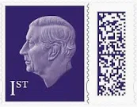
Ephesians 2: 1 -12
Royal Male

